Slide 1




Obesity Risk
Under supervision :
Eng:Abd Elrahman Eid
Made by:
Hajar El Behairy
Nagwa Mohamed
Mohamed Salama

Slide 2

Agenda
Introduction
Problem Statement
Key Findings
Approach
Results
Visualization
Conclusion & Recommendations

Slide 3

Problem
Predicting obesity risk based on lifestyle and demographic factors.
Multi-class classification problem to categorize individuals into different obesity risk levels.

Slide 4
Key Findings
Physical activity levels, caloric intake, and age are significant factors influencing obesity risk.
Various models were tested, with the highest accuracy achieved using XGBoost (92% on train, 91% on test).
Feature importance analysis revealed that lifestyle factors are strong predictors of obesity risk.

Slide 5
Approach
Data Preprocessing:
This step involves managing encoding categorical variables and scaling numerical features to ensure consistency and enhance model performance.
Feature Engineering: Identifying and selecting the most relevant features that contribute significantly to obesity risk prediction.

Slide 6
Approach
Model Training: Implementing and evaluating various algorithms, including:
Logistic Regression
Decision Tree
Random Forest
XGBoost
Hyperparameter Tuning:
Applying GridSearchCV to optimize model performance by selecting the best combination of hyperparameters

Slide 7

Best model:
XGBoost with approximately 92% accuracy on the training set and 91% accuracy on the test set.
Results
XGBoost outperformed other models by effectively capturing complex patterns in the data.
Various models were tested, with the highest accuracy achieved using XGBoost (92% on train, 91% on test).

Slide 8

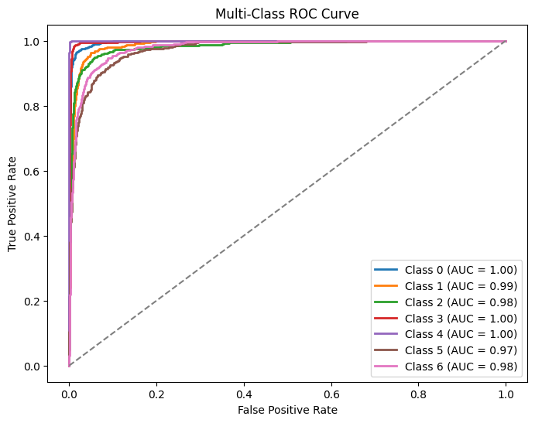
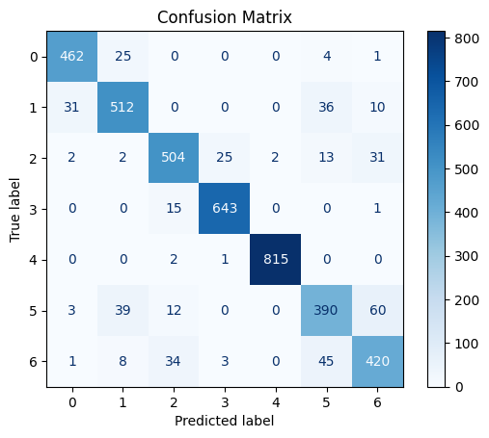
Results
Confusion matrices and classification reports indicate strong performance across all categories.

Slide 9
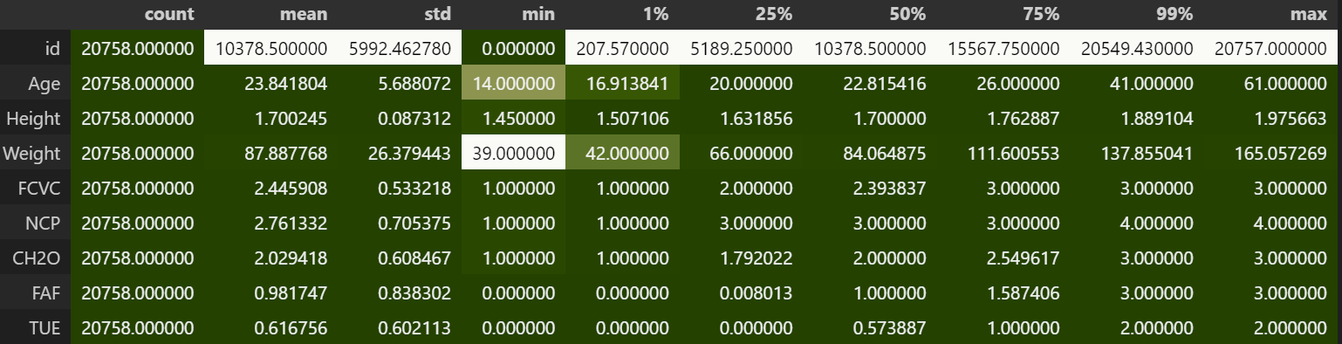
Visulizations
Descriptive Analysis

Slide 10
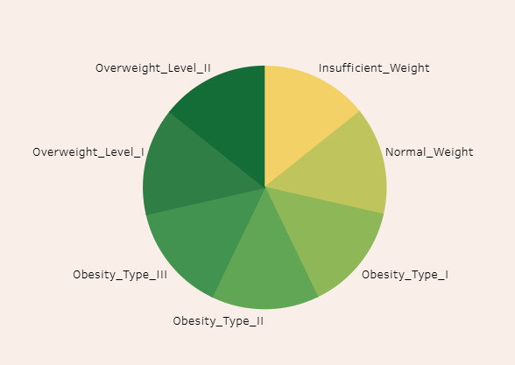
Visulizations

Slide 11
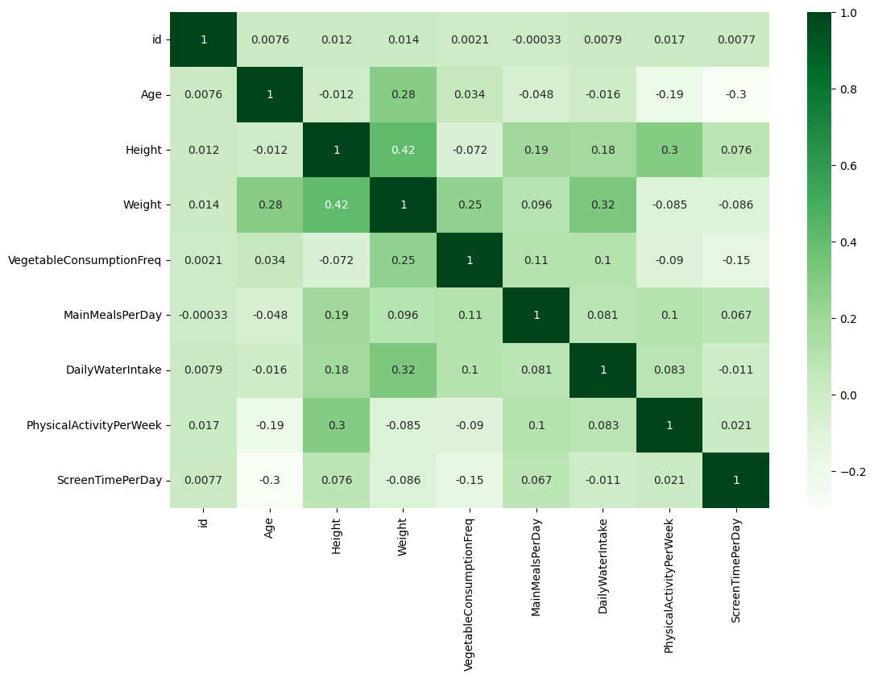
Visulizations

Slide 12
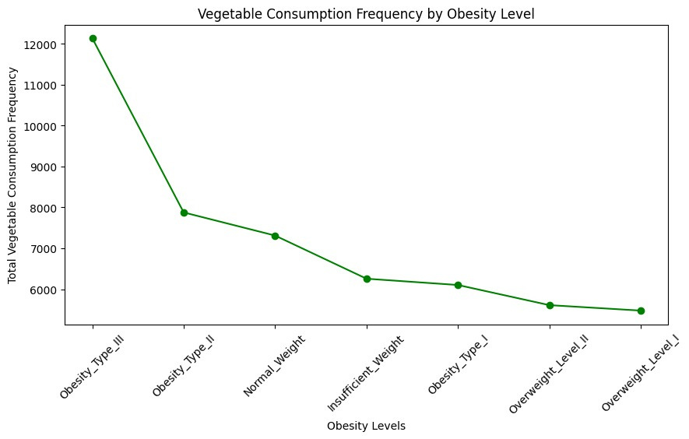
Visulizations

Slide 13
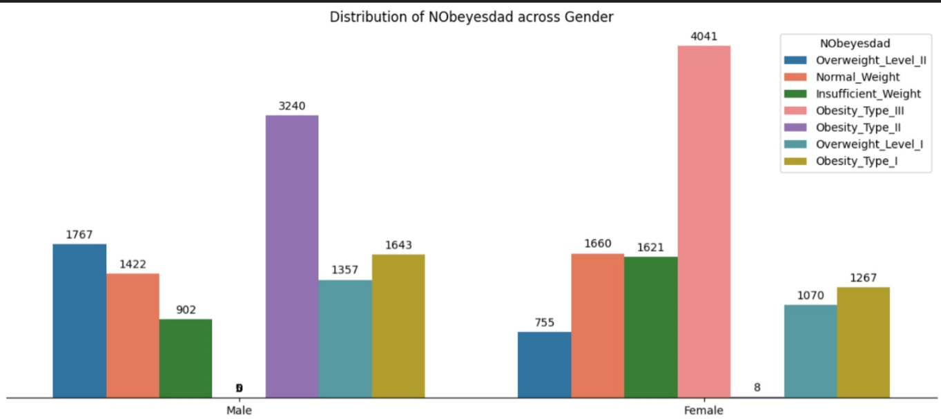
Visulizations
correlation between targett and gender

Slide 14
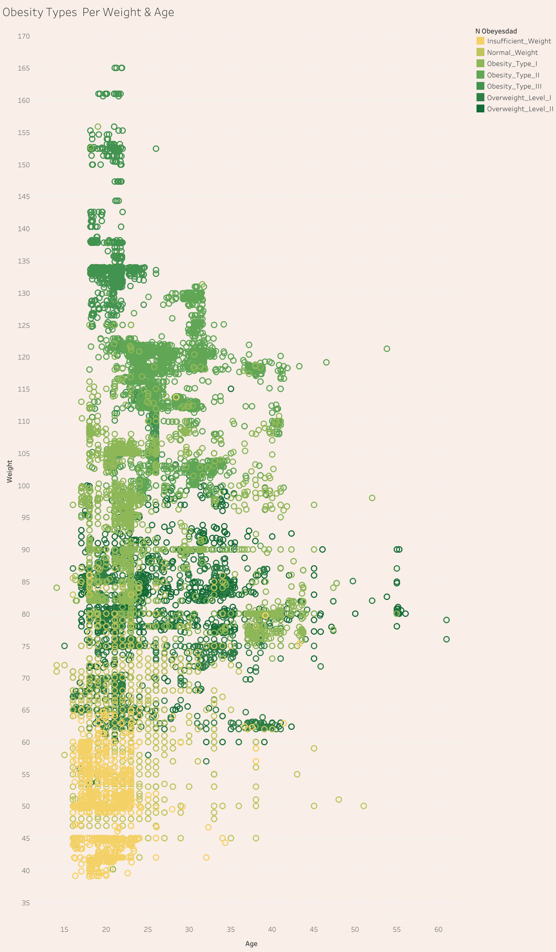
Visulizations
corralation between taregte and Age

Slide 15
Visulizations
For better interactive visualization check Tableau DashBoard
The LINK

Slide 16
Visulizations
for more exploring Descriptive Analysis check this notebook
link

Slide 17
Conclusion & Recommendations
Business Insight: Understanding obesity risk factors can guide targeted health interventions.
Technical Insight: Xgboost is highly effective for this problem; further improvement could be achieved through ensemble techniques or deep learning models.

Slide 18



Thank
You

